Slide 1

IST 303 CodeQuest
Milestone 1
Notes:
R

Slide 2
Overview
CodeQuest – Python Mastery
Team Members
Project Description:
A Python quiz web application designed to help users test their Python knowledge.
Includes user authentication, a quiz interface, and score tracking.
Built using FLASK, SQLite, and HTML/CSS for UI
Hla Win Tun
Emmanuel
Paniz
Rogelio
Notes:
R

Slide 3
Architecture Design
User
Flask App (Process User Request)
Database (Stores User Data & Scores)
Flask App (Retrieves Data from Database & Returns Response)
Response (Sends Quiz Score & Feedback)
The user interacts with the Flask App, which processes requests, stores quiz data in the database, and returns results in real time.
Notes:
R

Slide 4
How It Works
Flask App: Handles authentication & quiz logic
1
SQLite Database: Stores user credentials & scores
2
Response Handling: Sends real-time quiz results
3
Tech Stack: Flask (Backend), SQLite (Database), HTML/CSS (UI)
4
Notes:
R

Slide 5

What does the code do?
Notes:
P

Slide 6
Milestone 1.0 Goals
What we aimed to achieve:
Why this is important?
Sets the foundation for future enhancements in Milestone 2.0
Core Features: User registration, login, quiz functionality, score tracking
Agile Development: Sprint planning, stand-up meetings, burndown tracking
Deliverable: A functional Minimum Viable Product (MVP)
Notes:
P

Slide 7
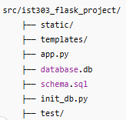
GitHub Repository Overview
Folder Structure:
What’s inside?
app.py: Main Flask application logic
database.db: SQLite database
schema.sql: Database schema
test/: Contains test_quiz.py for testing
Notes:
P

Slide 8
Code Breakdown (Frontend – HTML & CSS)
Templates:
templates/login.html
templates/quiz.html
templates/result.html
Styling:
static/style.css for UI improvements
Notes:
P

Slide 9

Code Breakdown (app.py)
Key Functions:
User Authentication: login(), register()
Quiz Logic: start_quiz(), evaluate_answer()
Score Tracking: update_score()
Notes:
P

Slide 10

Code Breakdown
Database Schema (schema.sql):
CREATE TABLE users (
id INTEGER PRIMARY KEY,
username TEXT NOT NULL UNIQUE,
password TEXT NOT NULL
);
CREATE TABLE quiz_questions (
id INTEGER PRIMARY KEY,
question TEXT NOT NULL,
answer TEXT NOT NULL
);
How is data stored & retrieved?
Uses SQLite
init_db.py initializes the database
Notes:
P

Slide 11
Demo
Notes:
W

Slide 12
Fulfillment of User Stories
Notes:
E

Slide 13

User Authentication (Register & Login)
Feature:
Users can register with a username & password.
Secure login system using session management.
Code Mapping:
app.py -> (login(), register())
User Story Mapping:
"As a user, I want to register and log in so that I can save my quiz progress."
Notes:
E

Slide 14

Quiz Functionality
Feature:
Users can start a quiz and answer Python-related questions.
Answers are validated in real-time.
Code Mapping:
app.py (quiz logic)
templates/quiz.html
User Story Mapping:
"As a user, I want to answer quiz questions and get feedback."
Notes:
E

Slide 15
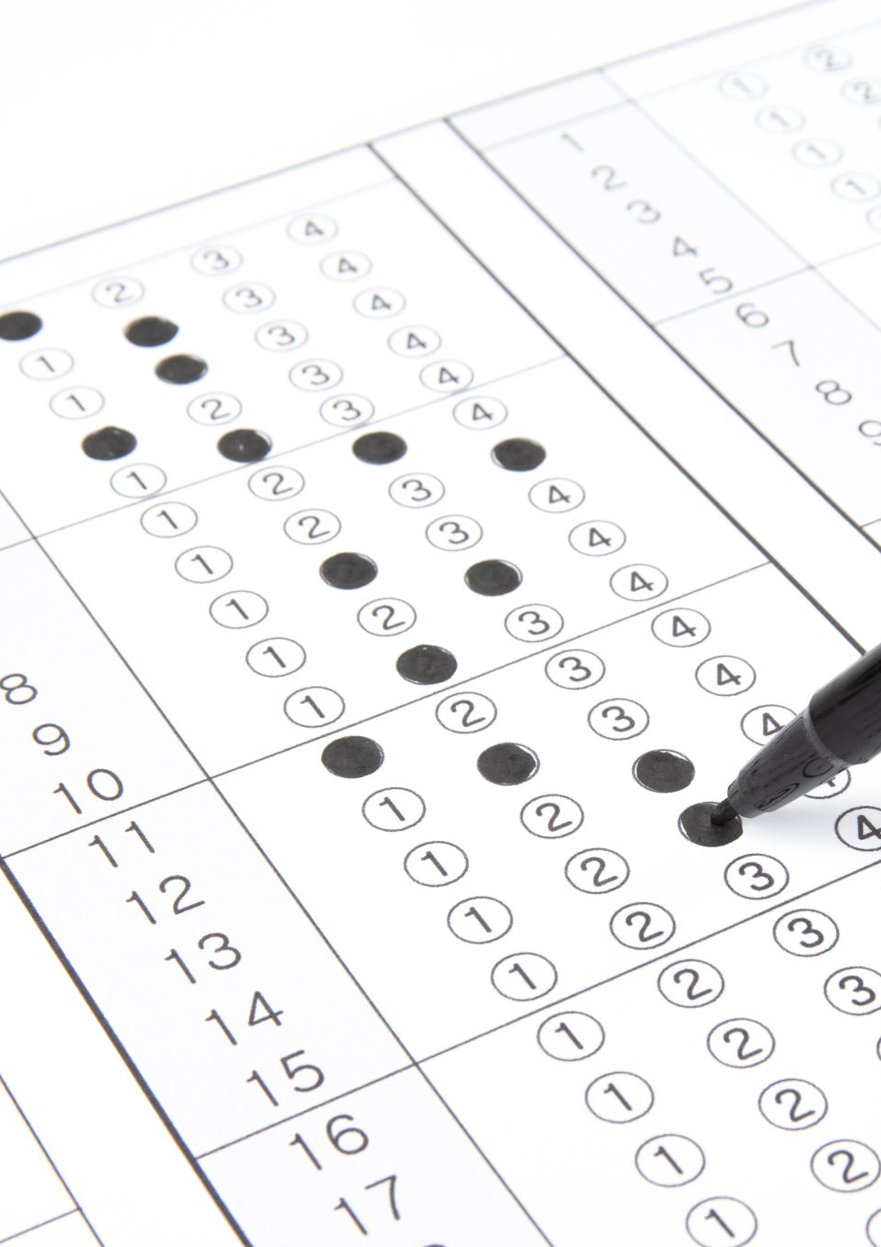
Score Tracking
Feature:
Users see their final score after completing the quiz.
Code Mapping:
app.py (score tracking)
templates/result.html
User Story Mapping:
"As a user, I want to see my final score after completing the quiz."
Notes:
E

Slide 16

UI Improvements
Feature:
Color-coded responses for correct/incorrect answers.
Navigation buttons added for usability.
Code Mapping:
style.css (UI styling)
User Story Mapping:
"As a user, I want an intuitive quiz interface that highlights correct/incorrect answers."
Notes:
E

Slide 17
Agile Methods
Notes:
W

Slide 18

Agile Progress
Feature:
Visual progress tracking using a burndown chart
Documented team meetings, sprints, and task breakdowns
Burndown Chart Highlights:
Planned vs. actual progress tracking
Agile methods used: iterations, regular sync up (minimum 2 meeting/week, sprint inspiration)
Notes:
W

Slide 19
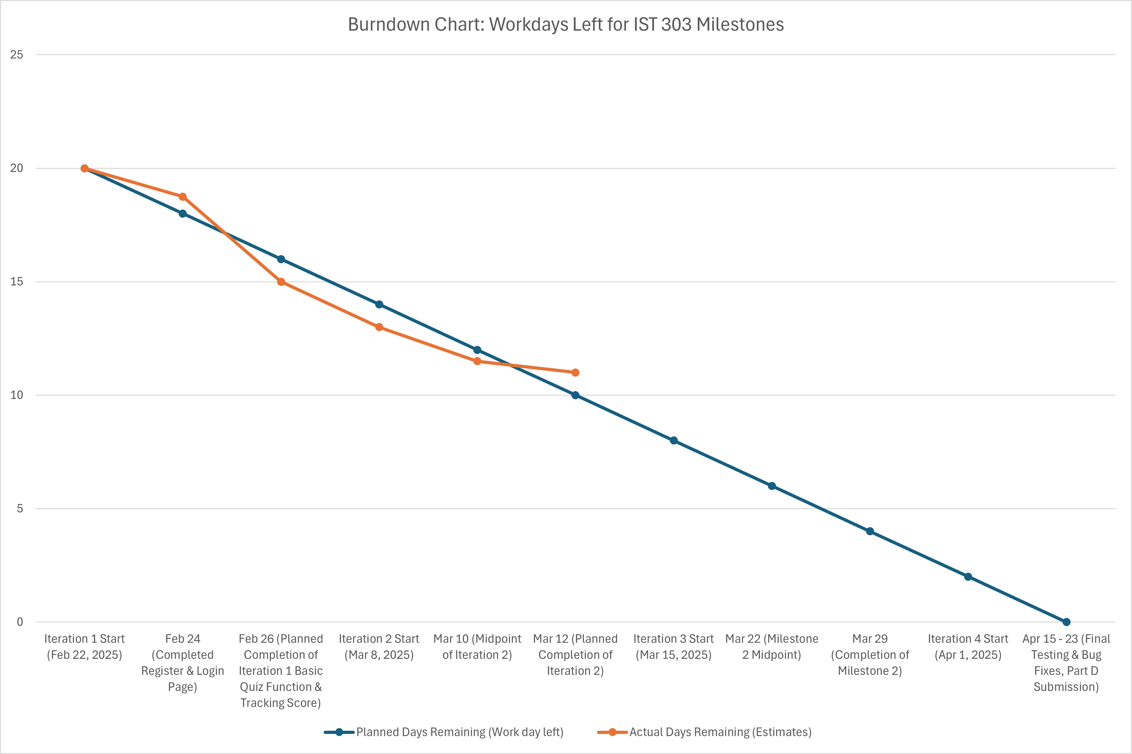
Our Burndown Chart & Rate
Notes:
W

Slide 20
Iteration Breakdown
Steady sprint velocity ensured core features were completed on time.
Iteration 1 focused on core quiz functionality (~20 points).
Iteration 2 focused on enhancements & testing (~14 points).
Minor UI delays in Iteration 1 were adjusted in Iteration 2.
Final MVP was completed before the March 12 deadline.
Iteration | Duration | Tasks Completed | Hours Spent | Velocity (Story Points)
Iteration 1 | Feb 22 – Mar 7 | Core Functionality & UI | 40 hours | 20 points
Iteration 2 | Mar 8 – Mar 22 | Enhancements & Testing | 40 hours | 14 points
Notes:
W

Slide 21
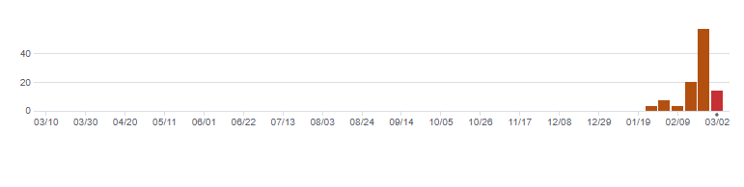
GitHub Commits & Agile Workflow
Proof of Agile workflow:
Frequent commits
Branching strategy: Feature branches merged into main
Team members actively committing & reviewing code
Notes:
W

Slide 22

Agile Documentation Summary
Key Artifacts:
Sprint Planning Documents
Meeting Notes Folder (meeting_notes/)
README.md
PART_B.md
PART_C.md
Notes:
W

Slide 23
Code Testing
Notes:
W

Slide 24

Code Testing Testing Methodology
Manual Testing:
Tested login, quiz, and score tracking
Multiple iterations with adjustments
Unit Tests (test/test_quiz.py)
Edge Cases Handled:
Invalid login attempts
Empty inputs in quiz answers
Correct vs. incorrect answer validation
Notes:
W

Slide 25

What's Next? (Milestone 2.0)
Notes:
P

Slide 26
Milestone 2.0 Goals
Next Features to Implement:
- Admin Panel: Allow teachers to manage quiz questions
- Leaderboard: Show top scores
- Improved UI/UX: Add animations, better styling
- More Question Categories: Python, SQL, Data Science (Not in Scope)
- User Empowerment: Own quiz creation by User (Not in Scope)
- Continued Testing: Test script writing (PyTest)
Notes:
P

Slide 27
Next steps & Final Timeline
Remaining Workload:
Task | Planned Completion
Finalize Admin Panel | March 20, 2024
Implement Leaderboard | March 27, 2025
UI Enhancement | April 5, 2025
Final Testing | April 15, 2025
Part D | April 23, 2025
Notes:
P

Slide 28

Thank You!

Slide 29
Breakdown by Iteration Iteration 1: Core Quiz Functionality & UI (Feb 22 - Mar 7)
Task | Hours | Story Points
Create register page | 5 | 2
Create login page | 5 | 2
Implement question display | 5 | 2
Capture user input for answers | 5 | 2
Validate correct/incorrect answers | 5 | 2
Format quiz UI | 6 | 2
Store quiz questions in JSON | 7 | 3
Error handling & input validation | 7 | 3
Basic score tracking | 5 | 2
Total for Iteration 1: 20 story points

Slide 30
Iteration 2: Enhancements & Testing (Mar 8 - Mar 12)
Task | Hours | Story Points
Improve UI with color-coded response | 5 | 2
Implement retry logic | 5 | 2
Develop admin panel quiz management | 15 | 5
Conduct internal testing & bug fixes | 10 | 3
Prepare for Part C presentation | 5 | 2
Total for Iteration 2: 14 story points

